Slide 1
What is Wrongful Death Lawyers?
Death resulting from an avoidable harm, either by wrongful conduct or gross negligence, is called “wrongful death.” In legal terms, it is known as a preventable death. This means that if the responsible party had acted as a reasonable person under the same or similar circumstances, the death would not have occurred. In elder or nursing home abuse and neglect cases, it occurs when the elderly patient dies as a result of neglect, abuse or inadequate treatment or care.

Slide 2
Types of Wrongful Death Lawyers
Automobile Accidents
Large Truck Accidents
Motorcycle Accidents
Elder Abuse/Nursing Home Abuse
Workplace Accidents

Slide 3
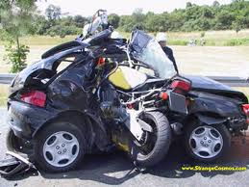
Automobile Accidents
An Automobile Accidents can change the lives of victims and their families forever by causing catastrophic injuries and even Wrongful Death.

Slide 4
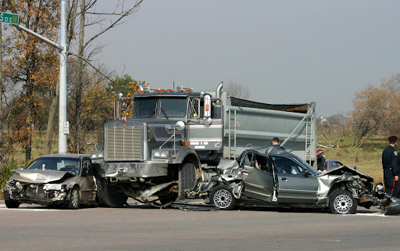
Large Truck Accidents
Accidents involving large trucks are among the most serious and most deadly in the United States. Each year truck crashes kill over 5,000 people and injure almost 150,000 more on our nation’s roads and highways. Nearly 25% of auto vehicle deaths involve a large truck. Large trucks are involved in multiple-vehicle fatal crashes at twice the rate of passenger vehicles.

Slide 5
Motorcycle Accidents
If you or someone you love has been in a motorcycle accident, the first step is to seek medical attention. Treatment will depend on the severity of the injury, but since most motorcycle accidents result in serious and debilitating injury or even death, the motorcyclist should be rushed to a hospital immediately after the collision.

Slide 6
Elder Abuse/Nursing Home Abuse
Although the nursing home industry is intended to provide a caring, nurturing environment for individuals in their golden years, some facilities are motivated more by profit than by proper patient care, so abuses occur. State and federal laws protect nursing home and assisted living facility residents and, with the help of a skilled attorney, nursing home abuse victims or survivors may be able to hold negligent nursing homes accountable and be compensated for their injuries and loss.

Slide 7
Workplace Accidents(Workers Compensation)
If you have suffered an on-the-job injury, you may be entitled to workers’ compensation. Workers’ compensation laws protect employees by holding employers responsible for any injuries that occur due to unsafe conditions at a place of work, and compensate employees for workplace injuries.

Slide 8
Contact us
Website: https://www.yorklawcorp.com/
Website: https://www.yorklawcorp.com/
Contact us: 800-939-1832
Email Id: info@yorklawcorp.com

